Slide 1
“Google Assistant based Home Automation using IOT ”
Mini Project - IV
ANAND T 1NH17EC005
Guided By
Prof. Richard Lincoln Paulraj
Assistant Professor
Dept. of ECE
New Horizon College of Engineering, Bengaluru

Slide 2
Contents
Introduction
Literature Review
Existing System
Problem Statement & Objectives
Proposed System
Block Diagram
Hardware & Software Specification
Circuit Diagram & Working
Algorithm / Flow Chart
Results & Discussion
Advantages
Conclusion & Future Scope
References
Progress Work
Milestones/Schedule

Slide 3
Introduction
Smart home Lights in recent times have become quite common, thanks to the growing IoT market. But more recently, we are getting to see these lights being controlled with just the power of voice (instead of apps) through AI assistants on people’s phones, speakers, computers, etc. However, these Smart Lights haven’t yet beaten the conventional lights in terms of price and hence require a bit of an investment. So, using a Raspberry pi 3B+ lying around, we can make our own Smartlight with a dumb one that can be controlled using Google assistant. The project will involve playing around with IFTTT and Adadruit IO services
The idea behind this is to control home devices with voice. Using personal assistant(Google Assistant) will do the work. Only required thing is to assist voice commands to the assistant. According to voice commands home appliances will switch ON/OFF

Slide 4
Literature Review
Title of the paper | Author & Year of Publication | Outcome | Limitation
Home Automation Based On IoT Using Google Assistant | D.Swathi , Vol 6 Issue 1 January 2019 | Controlling the operations of various objects is achieved. | ----
Google Assistant Controlled Home Automation
Manish Prakash Gupta
Volume: 05 Issue: 05 |
May-2018
By using nodeMCU and Blynk app Home automation was completed
---
Interactive Home Automation System with Google Assistant
Mummaka Sai Srinath,Volume 119 No. 12 2018
Controlling the operation of LED was achieved.
---

Slide 5
Existing System
In the existing system, IOT i.e. IEEE 802.11 b/g/n is used in order to control the home appliances where the home appliances are remotely controlled using a web page buttons, where we have to go to the particular link and from there we can press buttons in order to control the home appliance.
The project presents a design and prototype of Home Automation system that will use ESP8266 Wi-Fi module as a network provider in connecting with other appliances. The proposed system has two main components. The first main part is Arduino, which controls and manages input of Wi-Fi module.
The system is implemented using ordinary household appliances Natural language voice commands are given to the Google Assistant and with the help of IFTTT (If This Then That) application and the Blynk application the commands are decoded and then sent to the microcontroller, the microcontroller in turn controls the output of a particular object.

Slide 6
Problem Statement & Objectives
Problem Statement: As there is chance of forgetting turning off the application at home, so by the help of this application we are able control the applications at home with the help of “Google Assistant based Home Automation using IOT”.
Objectives: The idea of the project is to integrate the concept of Google Assistant into Raspberry Pi and control the appliances in the home that the device is installed. Google recently released an API(Application programming interface) for Google Assistant, for platforms other than Android, such as Linux and Windows, using Python language. This makes it simpler to program into the Raspberry Pi, and lighter compared to other programming languages

Slide 7
Proposed System
In this proposed system, Raspberry pi is installed with an Adafruit.io account where we are supposed to write our code ,this code tells what operations are to be performed . Then it has to be linked with IFTTT(If This then That) server which connects between Raspberry pi and the Adafruit.io.
Then adding to Google Assistant for voice command which needs to be installed in the phone and for all this operation to take place it has to be linked to a same gmail account.
By using the inbuilt Wi-Fi module present in the Raspberry Pi we are able to connect it to Adafruit.io and IFTTT website we are able to control the applications that are present in home.

Slide 8
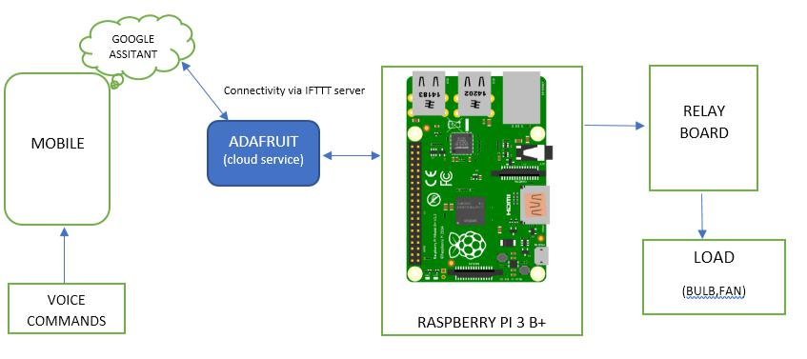
Block Diagram

Slide 9
Hardware & Software Specification
Hardware Specifications:
Raspberry Pi: A Raspberry Pi device, designed for educational purposes, that expands the Raspberry Pi's GPIO pins to allow interface with and control of LEDs, switches, analog signals, sensors and other devices.
Software Specifications:
Raspberry OS: Raspbian is the operating system for Raspberry Pi. Raspbian is highly optimized for the Raspberry Pi line's low-performance.
Adafruit.io: It is one of the IoT company which provides cloud service to raspberry pi and is used for building and flashing code
IFTTT: “If this then that” is a website which is used as a server between Raspberry Pi and Adafruit.io.
Setting up raspberry with raspbian OS requires additional softwares and hardwares.

Slide 10
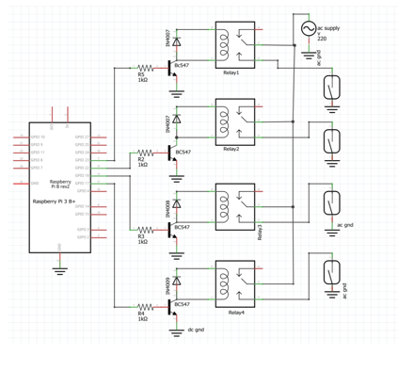
Circuit Diagram & Working

Slide 11
Working
Wiring: Since Adafruit agent provides cloud services to multiple devices, it has standard labeling for peripherals, so separate labelling description has to be followed inorder to connect with GPIO pins of pi.
Adafruit IO agent setup: Adafruit agent is installed on raspian and it should be connected to cloud with the Adafruit account. Once the raspian gets connected to cloud. Code is developed in Adafruit web Build IDE and it can be flashed to raspberry pi using same.
IFTTT setup: It has two sections ‘this’ and ‘that’. IFFTT account should be signed up through gmail account, the account which is connected to google assistant. Both the platforms must be logged in with that same account. Multiple applets are created for the respective multiple commands. Those applets are meant for google assistant and are created in ‘this’ section. The applets which are created in ‘this’ section are published as unique events in ‘that’ section which is Adafruit.io
‘this’ section refers to Google assistant.
‘that’ section refers to Adafruit agent.

Slide 12
Working(Cont..)
Thus IFTTT connects google assistant and Adafruit, hence the name “if this
then that”.
Create Adafruit:Create a new Dashboard at Adafruit. This dashboard is a user interface to control things remotely, Now, create feed (user interface) to control light On-Off. To create it, just click on ‘+’ symbol and select toggle feed the next step configure the feed
These are the fundamental blocks which are interlinked with one another. When the voice command (say led on) is given to Google assistant, the applet created in IFTTT for that command invokes its respective event (turn on led) and IFTTT publishes that event to Adafruit. As mentioned earlier, Particle being cloud and includes our code in its IDE, it captures the event which was published by IFTTT and calls Adafruit IO function, this function in turn calls handler function (switchon) and executes statements in it.

Slide 13
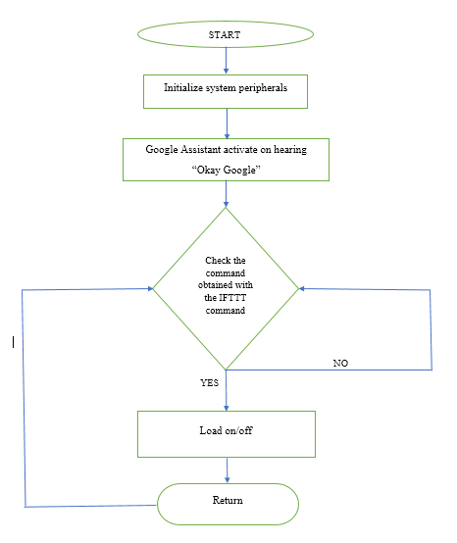
Algorithm / Flow Chart

Slide 14
Results & Discussion
The results were positive and we were able to successfully control the multiple devices by giving suitable voice commands to google assistant.
There are many factors to improve on to make it more powerful, intelligent, scalable, and to become better overall for home automation. For example, controlling the speed of the fan, a greater number of devices can be integrated, like a coffee machine, air conditioner etc., and can be embedded based on the user dependency to make it more sustainable.

Slide 15
Advantages
Lights, fans and any ac appliance can be easily controlled via voice commands, so that old aged and physically challenged people can highly reliable on the system.
Allow us to take control over switching of ac appliances when out of town or not in condition to change the switches manually.
Low power consumption and setup is compact in size.
Events can be monitored on Adafruit console with precise date and time.
Mail will be sent to linked IFTTT account with event description as soon as the event gets published.
Since Raspberry pi 3b+ comes with multiple peripherals, proposed system can be upgraded to include security cameras, sensors for safety enhancements.

Slide 16
Conclusion & Future Scope
Conclusion
Multiple devices are the subjective elements in a common in low class or middle class room. Giving access of their home in their pockets or in their hands is a challenging task that completes our objective and motto of this project.
Future Scope
The future scope for this project can be huge. There are many factors to improve on to make it more powerful, intelligent, scalable, and to become better overall for home automation. It always has a scope for improvement

Slide 17
References
[1] Prof. Prashant Rathod, Syed Khizaruddin, Rashmi Kotian, Shubham Lal – “Raspberry Pi Based Home
Automation Using Wi-Fi, IOT & Android for Live Monitoring“ -IJCST – Volume 5 Issue 2, Mar – April
2017
[2] IFTTT: https://ifttt.com/discover https://www.pocketlint.com/SmartHome/SmarHomenews
[3] Google Assistant: https://assistant.google.com/intl/en_in/
https://www.pocketlint.com/Apps/Appsnews/Googleappnews
[4] Adafruit.io: https://docs.particle.io/tutorials/developer-tools/build
[5] Raspberry Pi: https://www.raspberrypi.org/documentation

Slide 18
Milestones/Schedule
Milestone | Baseline Date | Target Date | Achievement
Installation of Raspbian OS and some additional software's. | 02/02/2020 | 05/02/2020 | 6/02/2020
Analysing of different IOT cloud services and servers. | 10/02/2020 | 19/02/2020 | 21/02/2020
Writing a c++ code and testing | 25/02/2020 | 05/03/2020 | 08/03/2020
Interfacing of hardware components with raspberry pi | 10/03/2020 | 13/03/2020 | 14/03/2020

Slide 19
Thank You

